Slide 1


DESKTOP AUTOMATION FRAMEWORK
05/2023

Slide 2


TABLE OF CONTENTS
01.
04.
06.
PURPOSE
FLAUI & FLAUINSPECT
REPORTING & CI/CD
02.
05.
07.
FRAMEWORK ECOSYSTEM
POM & TDD
DEMO
03.
FRAMEWORK STRUCTURE
Notes:
Q&A during presentation

Slide 3


PURPOSE

Slide 4


PURPOSE
How Automation testing provides significant efforts and cost savings
Overview Automated Testing: Your End-to-End Ecosystem
Recognize the essential components required for an automation framework
Introduce a framework to automate test cases for multi-type of Desktop Application
Improving the Value of Report Integration and Extensibility:
Additional test management systems such as Zephyr Scale, reporting tools like Allure Report and Reportportal.io, and enable seamless test execution with CI/CD.
Reducing Code Duplication and Enhancing Test Case Maintenance:
Implement the Page Object Model design pattern (POM)
Incorporate Data-Driven Testing (DDT)
Notes:
Automation testing provides significant efforts and cost savings in terms of execution time, test coverage, resource optimization, maintenance, and early bug detection
Enhance the valuation of report integration by extending its compatibility with additional test management systems such as Zephyr Scale, reporting tools like Allure Report and Reportportal.io, and enable seamless test execution with CI/CD.
Reducing Code Duplication and Enhancing Test Case Maintenance:
Implement the Page Object Model design pattern (POM) to minimize code duplication and improve the maintainability of test cases.
Incorporate Data-Driven Testing (DDT) to enhance test case maintenance by separating test data from test scripts and enabling easy updates and modifications.
Incorporate Data-Driven Testing (DDT) to enhance test case maintenance by separating test data from test scripts and enabling easy updates and modifications.

Slide 5
PURPOSE – ROI OF CALCULATION
Complexity | Medium
Test Coverage | 73.81%
# of Manual Test Cases | 2100
# of Automated Test Cases | 1550
Avg. Execution Time of Manual Test Cases (min) | 45
Avg. Execution Time of Automation Test Cases (min) | 5
Avg. Development Time of Automation Test Cases (min) | 15
Avg. Development Time of Manual Test Cases (min) | 120
Number of Test Server Instances | 12
Nightly Run | Yes
Number of Test Cycles | 20
License Cost | $759
Initial Infrastructure Cost | $0
The table below illustrates the investment of a real Automation Testing project:
ROI= ((Gain from Investment - Cost of Investment)⁄Cost of Investment) x 100
Tasks | Manual (hrs) | Automation (hrs) | Saving ($)
Initial Setup & Management | 0.00 | 8.00 | -200.00
Testing Initiation (Training,...) | 0.00 | 24.00 | -600.00
Test Planning | 104.00 | 264.00 | -4000.00
Test Design | 0.19 | 3410.00 | -85245.16
Test Execution | 1395.00 | 18.30 | 34417.53
Test Regression | 27900.00 | 150.00 | 693732.64
Reporting | 56.00 | 205.00 | -3725.00
Notes:
Then we compare that to the efforts going into Manual Testing, and how much the team saved using Automation Testing.

Slide 6
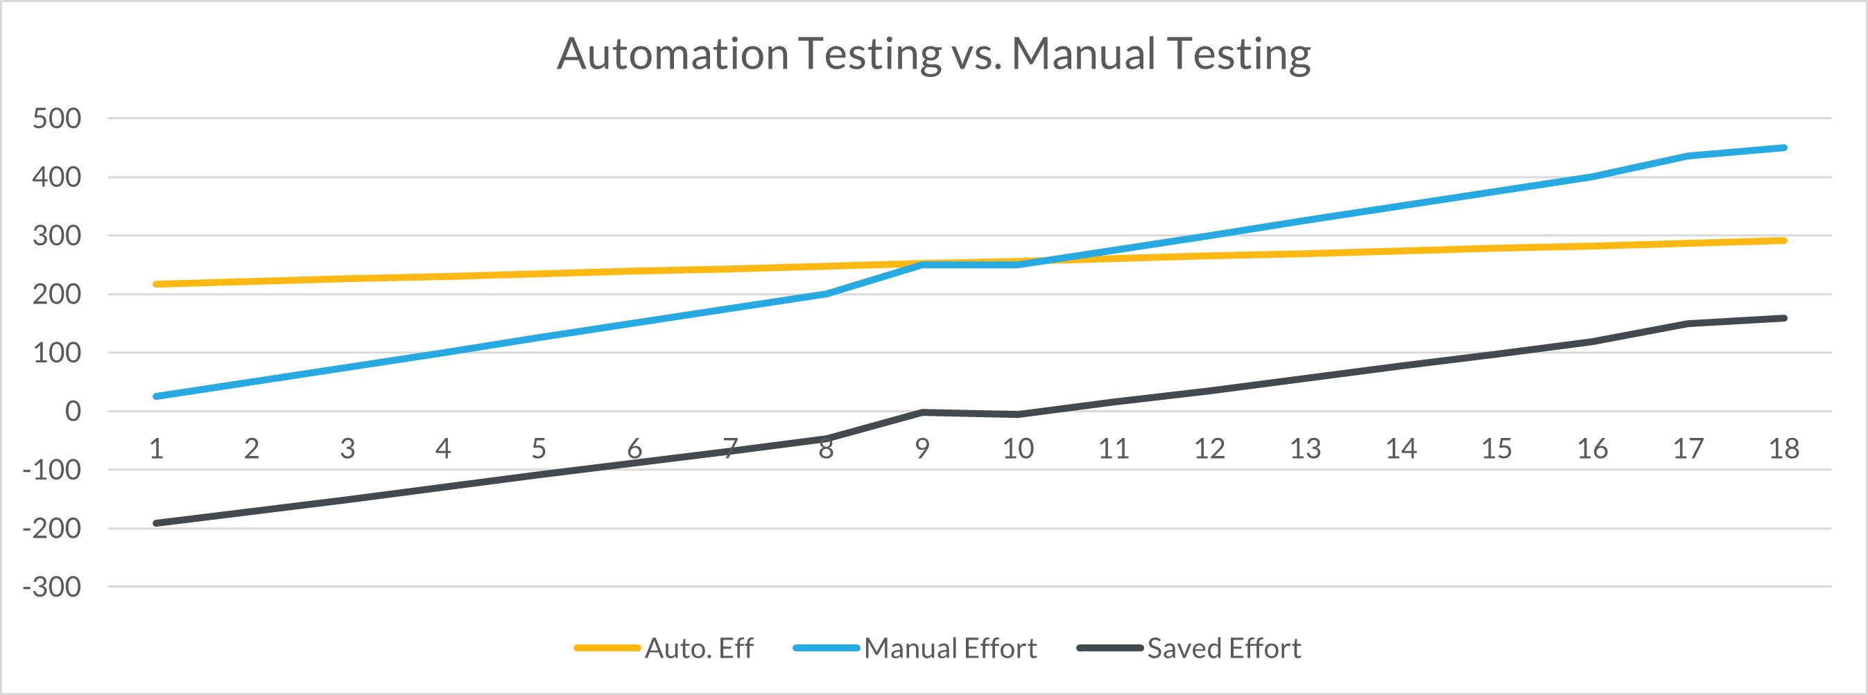
PURPOSE
Notes:
The graph and chart below illustrate some interesting facts about Test Automation. In about the first 10 months of starting, Automation Testing costs way more than Manual Testing. But after this period, Automation Testing starts to show its potential, where the efforts and money saved skyrocketing.
https://blog.kms-solutions.asia/how-to-calculate-return-on-investment-roi-of-automation-testing

Slide 7
FRAMEWORK ECOSYSTEM

Slide 8
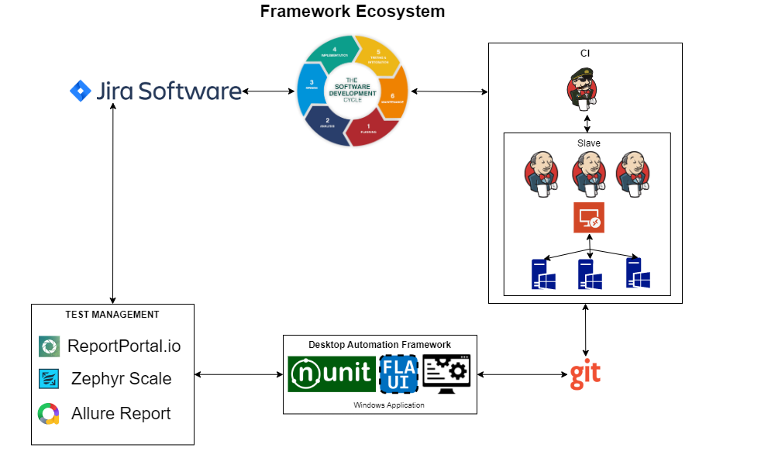
FRAMEWORK ECOSYSTEM

Slide 9
FRAMEWORK STRUCTURE

Slide 10
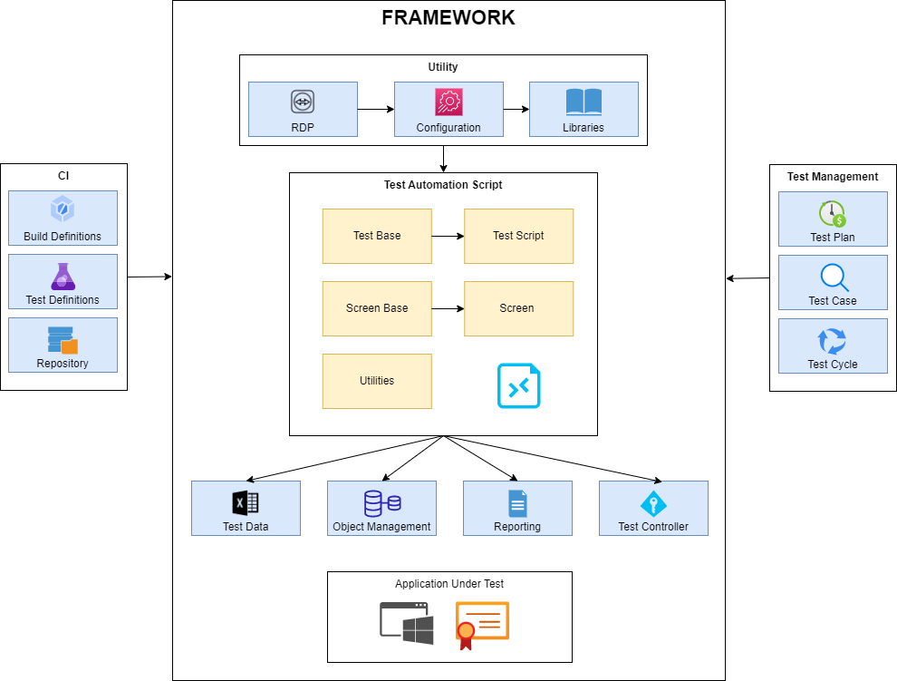
FRAMEWORK STRUCTURE

Slide 11
FLAUI & FLAUINSPECT

Slide 12
DIFFERENCE TYPE OF WINDOWS APPLICATION
UIA2 is a managed library for native UI Automation API that was introduced in .NET Framework 3.0. It does not support newer features such as touch and it also does not work well with WPF or Windows Store Apps.
UIA3 is a COM library for native UI Automation API that was introduced in Windows 7. It works great for WPF and Windows Store Apps
FlaUI is a UI automation library for .NET that helps with automated testing of Windows applications based on native UI Automation libraries from Microsoft and supports two versions of them: UIA2 and UIA3.
UIA2
UIA3
FlaUI

Slide 13
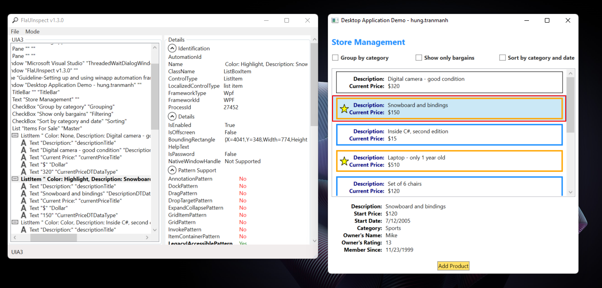
FLAUINSPECT

Slide 14
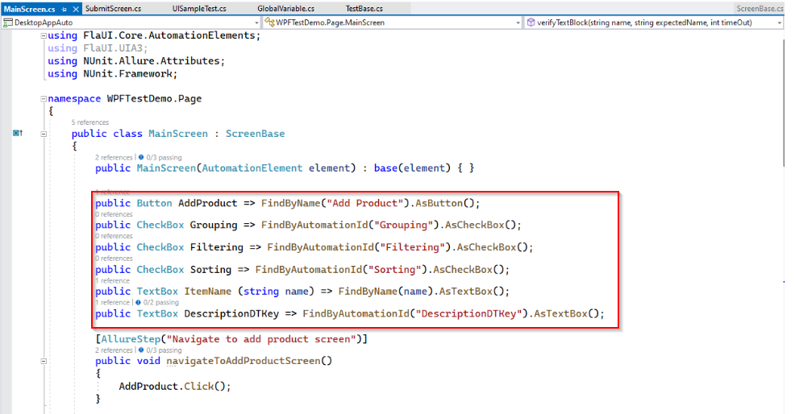
FLAUINSPECT

Slide 15
POM & TDD

Slide 16
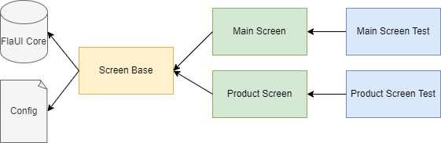
PAGE OBJECT MODEL DESIGN PATTERN

Slide 17
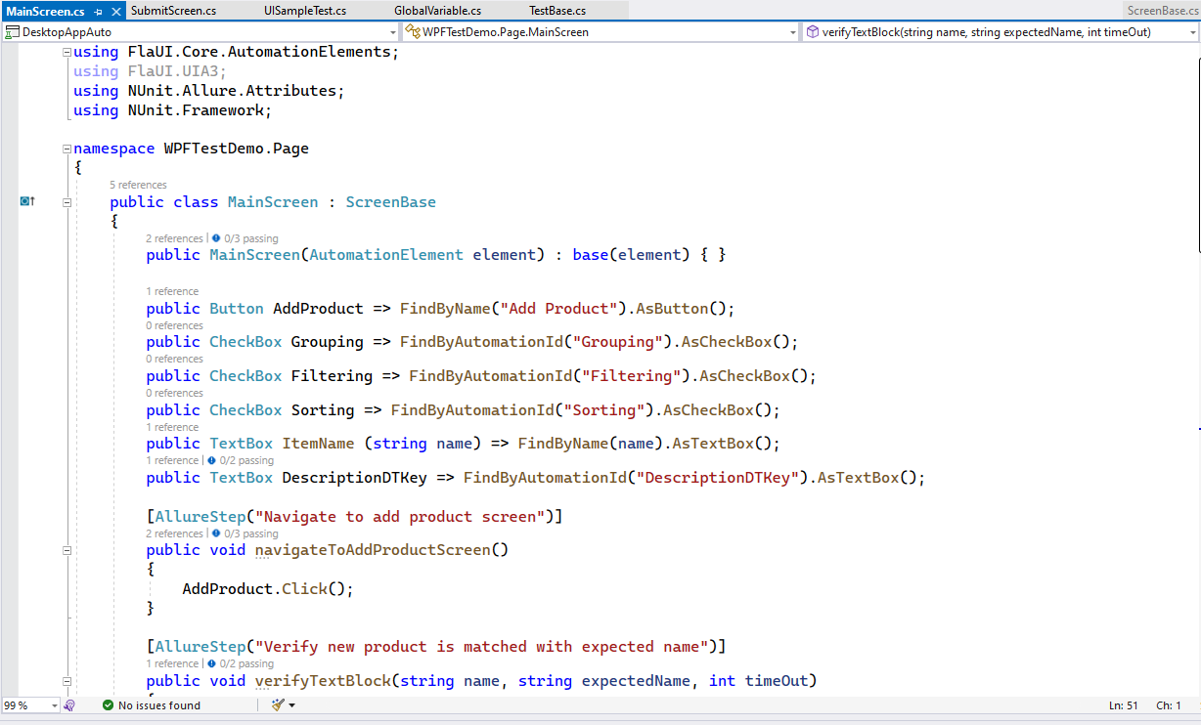
PAGE OBJECT MODEL DESIGN PATTERN

Slide 18
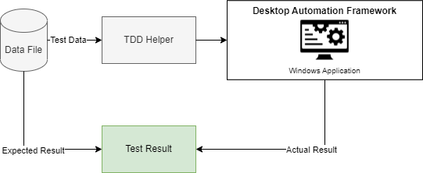
DATA-DRIVEN TESTING(DDT)

Slide 19
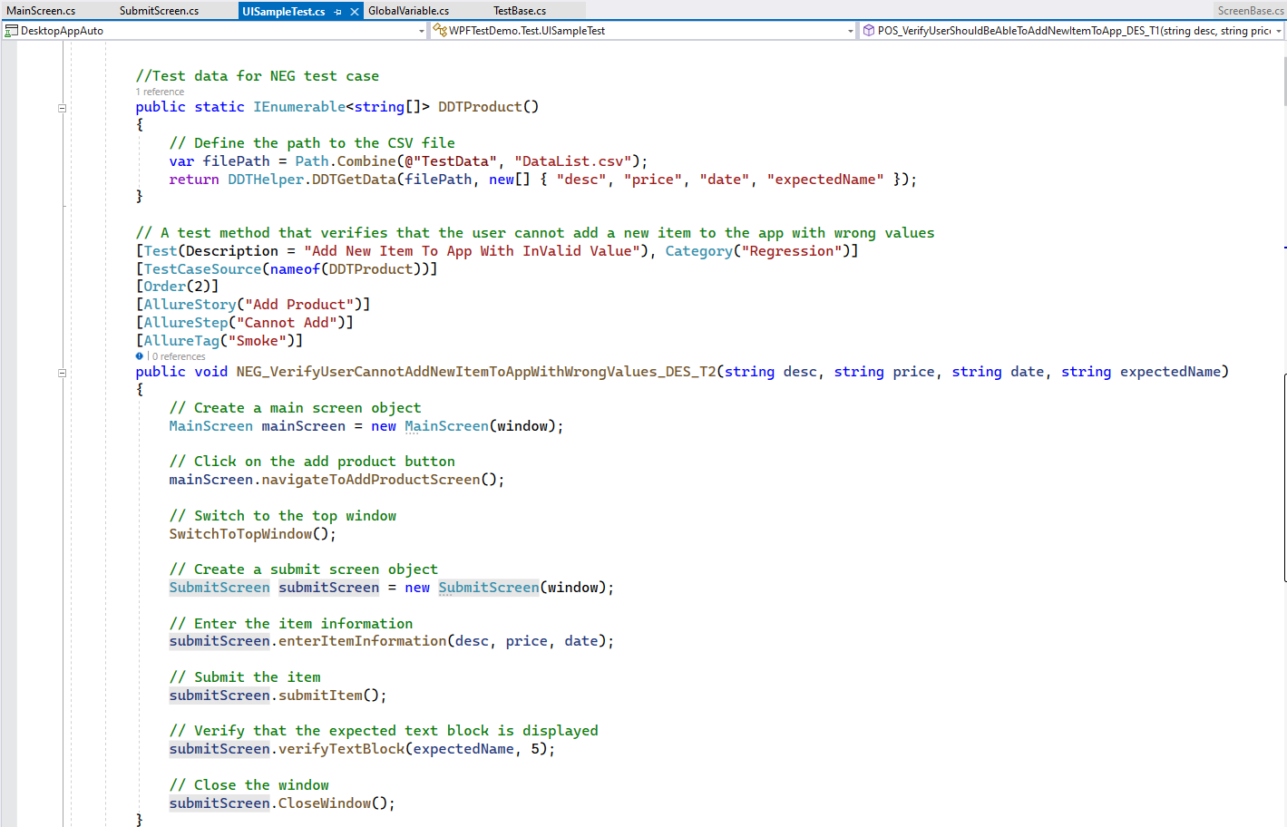
DATA-DRIVEN TESTING(DDT)

Slide 20
REPORTING & CI/CD

Slide 21
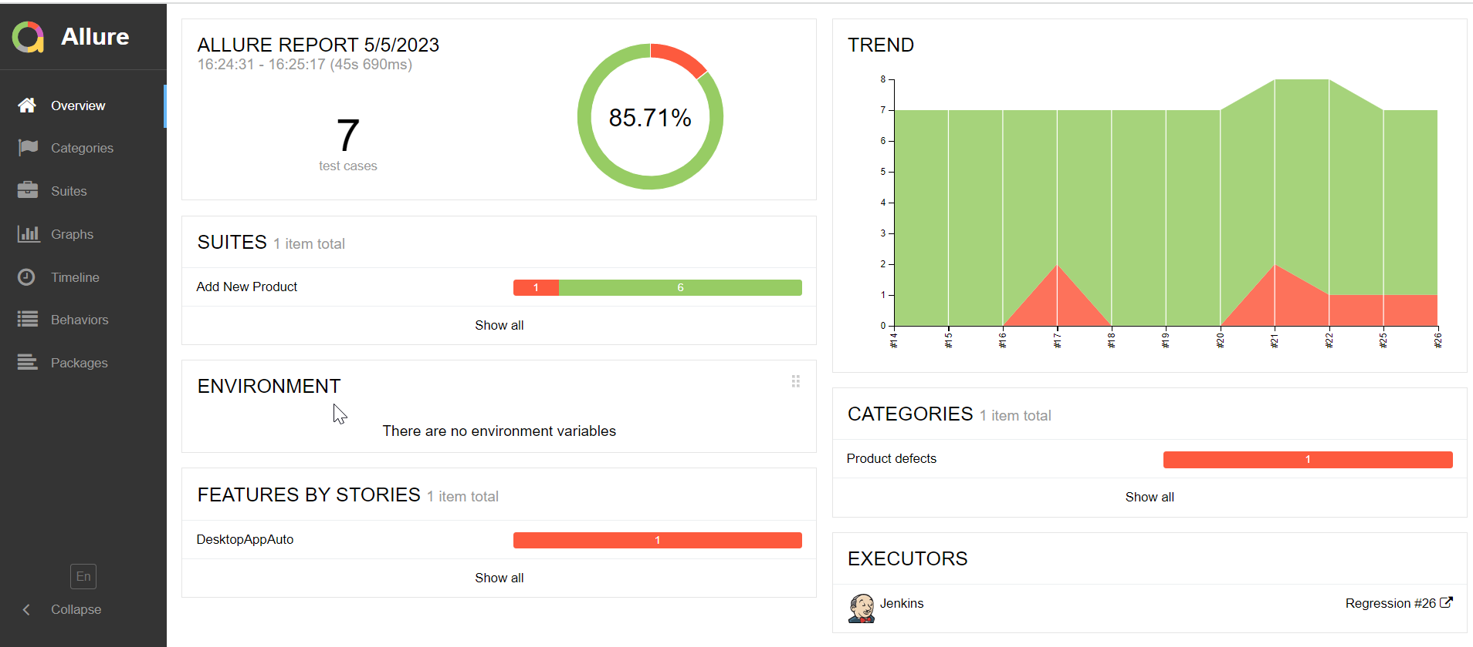
REPORTING – ALLURE REPORT
Notes:
Categories
Report pass/fail
Capture screenshot for failed test case
Tracking success rate for each test case

Slide 22
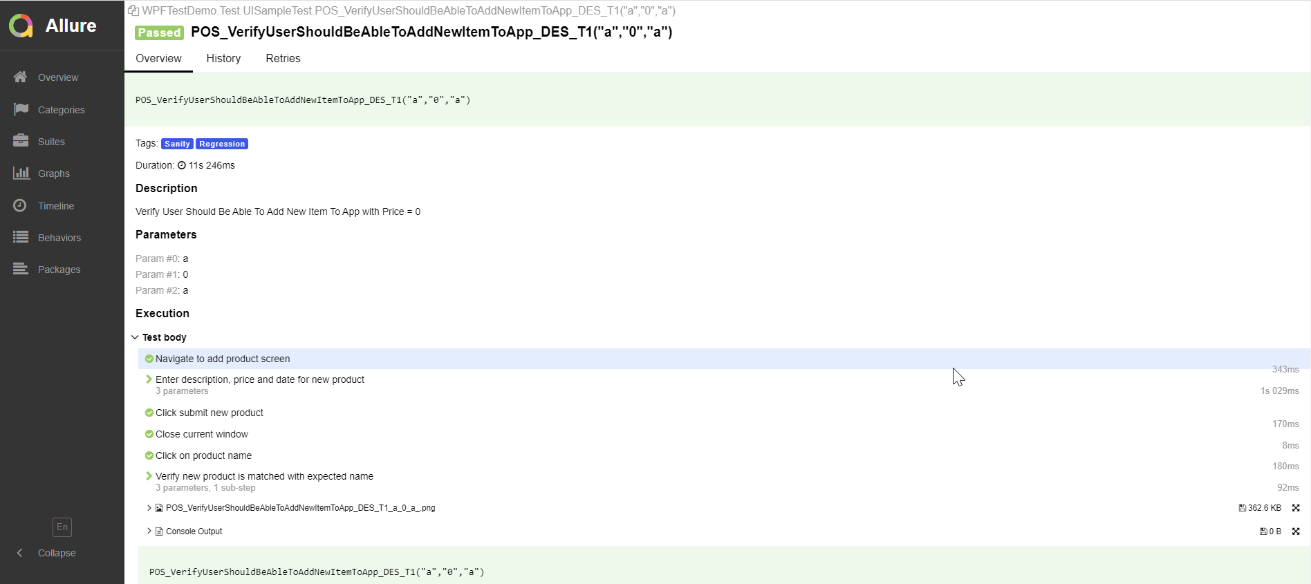
REPORTING – ALLURE REPORT
Notes:
Detail test case summary
Step summary
Screenshot for failed test case
Parameter for test cases

Slide 23
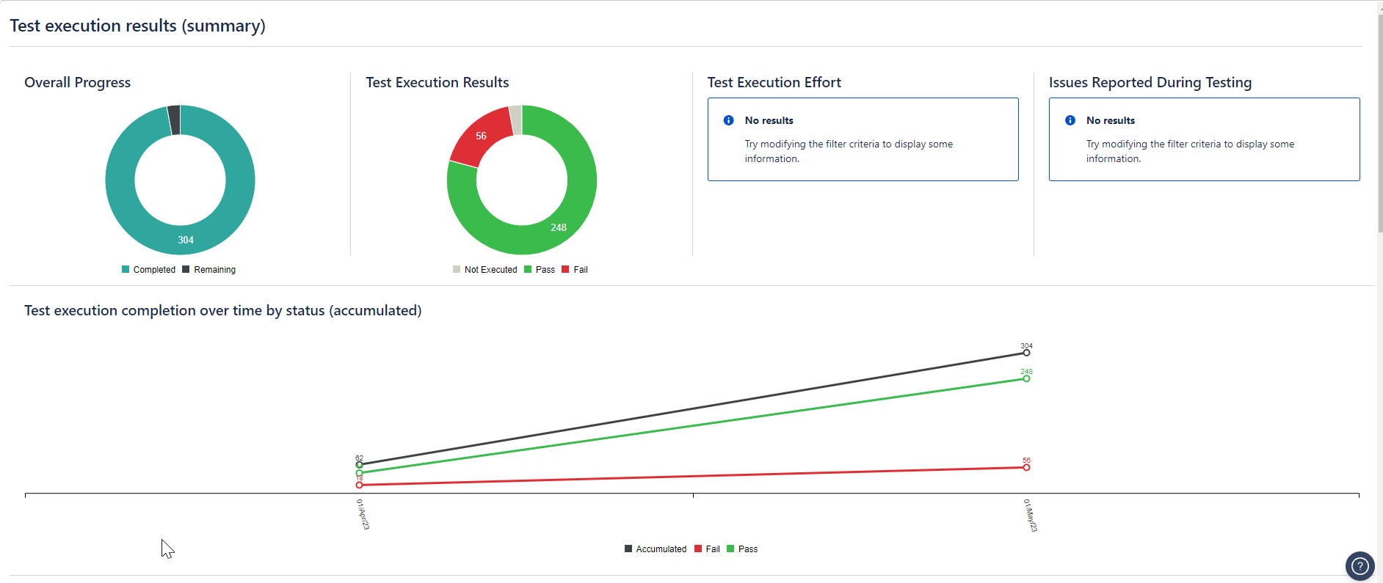
REPORTING – ZEPHYR REPORT
Notes:
Tracking for both manual and automation test

Slide 24
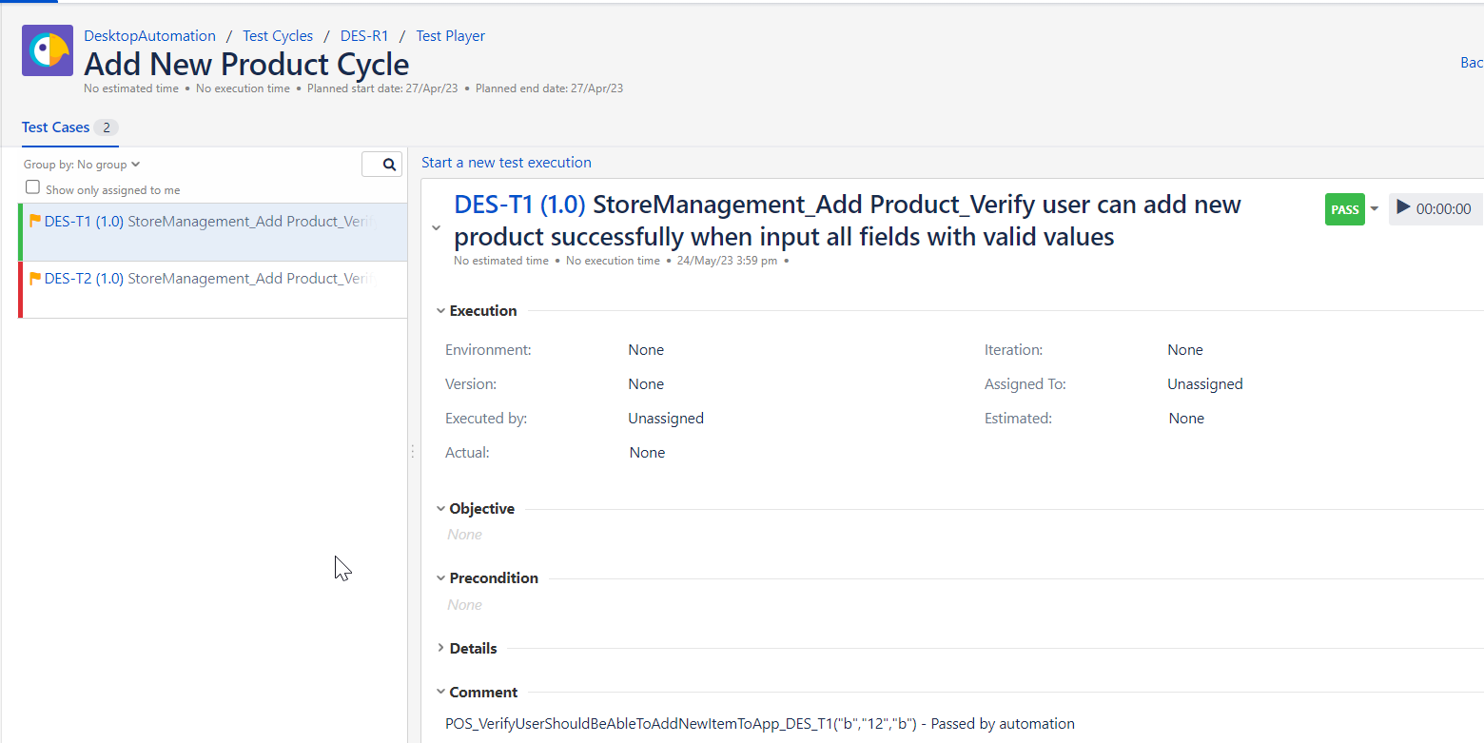
REPORTING – ZEPHYR REPORT

Slide 25
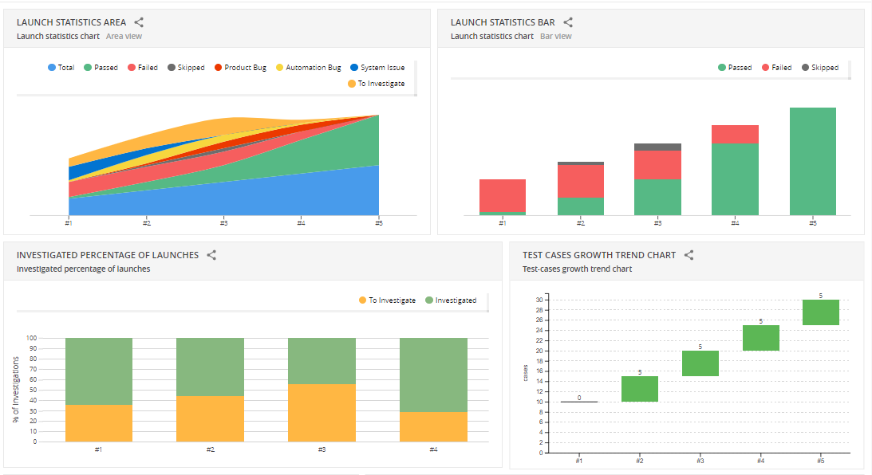
REPORTING – REPORTPORTAL.IO
Notes:
Tracking for both manual and automation test

Slide 26
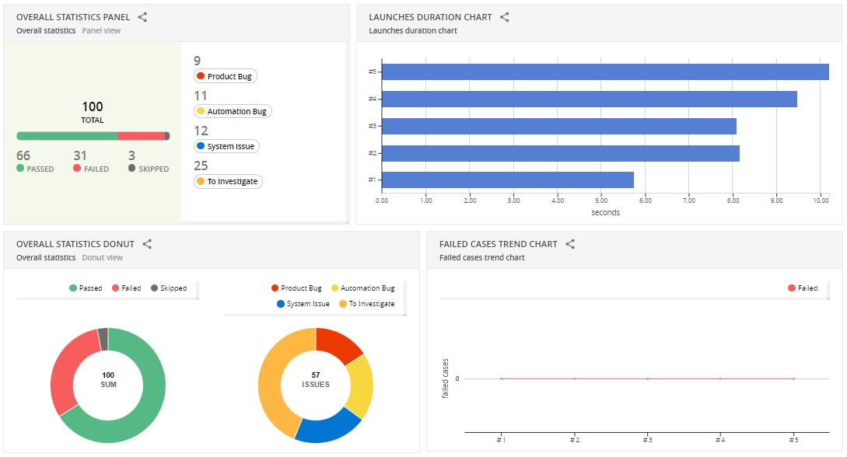
REPORTING – REPORTPORTAL.IO

Slide 27
DEMO
Notes:
Jira https://hungtranmanh.atlassian.net/jira/software/projects/DES/boards/1
Ticket Detail: https://hungtranmanh.atlassian.net/jira/software/projects/DES/boards/1?selectedIssue=DES-1
Create test plan, test cycle, test execution, link manual defect: https://hungtranmanh.atlassian.net/projects/DES?selectedItem=com.atlassian.plugins.atlassian-connect-plugin:com.kanoah.test-manager__main-project-page#!/testPlayer/DES-R1
Create automation script:
Integrate with Jenkins: http://localhost:9090/
View execution status http://localhost:9090/job/Sanity/allure/
http://localhost:8080/ui/#automation_demo/launches/all
https://hungtranmanh.atlassian.net/projects/DES?selectedItem=com.atlassian.plugins.atlassian-connect-plugin:com.kanoah.test-manager__main-project-page#!/testPlayer/DES-R1
View report

